Slide 1
KPMG Data Analytics Team
Sprocket Central Pty ltd.
Data Analytics approach
Presented by Jainam Shah, Junior Consultant, Data Analytics team.

Slide 2
Agenda
Introduction
Data Exploration
Data Development
Interpretation

Slide 3
Target customers Analysis
Look into these factors in new customers:
Age distributions
Number of bike purchases in 3 years / percentages purchases
Job industry category.
Wealth segments
Number of cars own on each states.

Slide 4
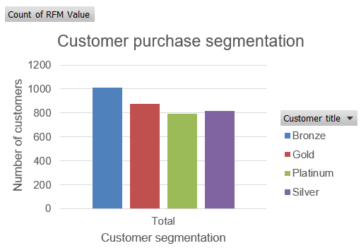
Customer Segmentation
Here we have divided customers into segments of Platinum, Gold, Silver and Bronze.
These segments are based on “Recency”, “Monetary” and “Frequency” factors.
Since there are 800 platinum customers, we should start targeting them first as they’re most promising.
Since most of our customers lies in bronze category, we shall start to bring them in Silver & upper qualities.
Customer belonging in Silver and Gold class shall be targeted as per norms.

Slide 5
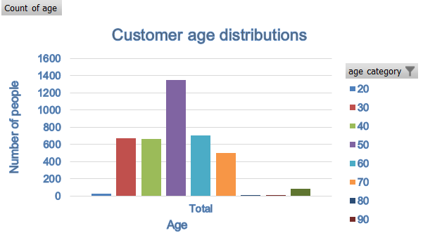
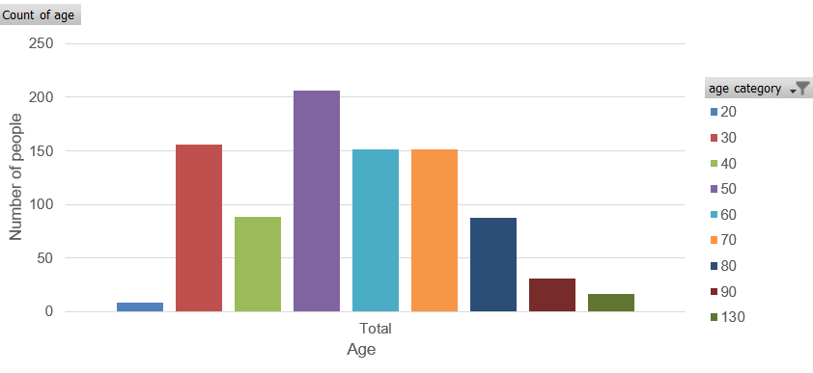
Customer age distribution:
Most customer are in the age group of 50s. There might be 2 categories in this group age. First, people buying this for their kids/grandkids and other category being fitness centric people.
It is assumed that most purchases would be made by category 1 customers, hence targeting advertisements should be created in a scenario where a grandfather buys cycle for his grandkids.
The next most prominent age group is 30s and 40s so above strategy will work as well in this scenario.

Slide 6
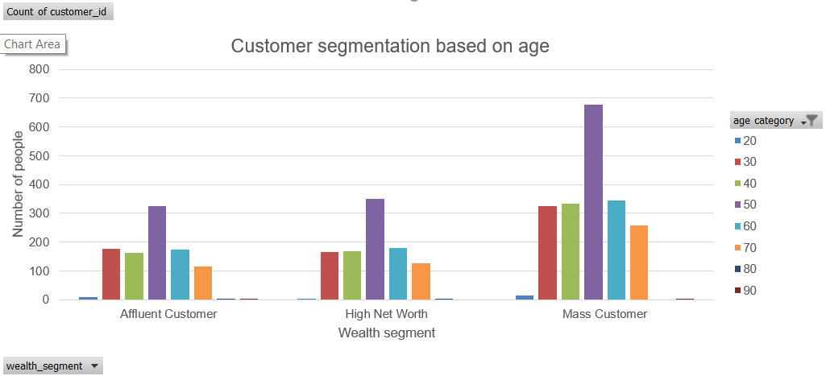
Customer segmentation based on age and wealth segment:
People in their 50s and in the mass customer segment holds most of our purchases. We should focus on them.
Also in High net worth customers in their 30s to 50s bring most of our sales.

Slide 7
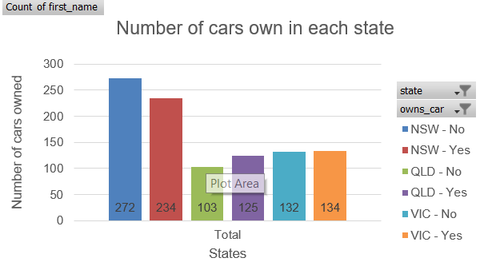
Cars owned in states of Australia:
Cars owned data segmented by states New South Wales, Queensland and Victoria.
Most cars are owned in New South Wales followed by Victoria and Queensland.
Thus now we have a perspective of customers demographic as well.

Slide 8
Appendix

Slide 9
All supporting items are in the attachment.

